Slide 1
League of Legends Match Prediction
Team-3
CSE3202: Artificial Intelligence and Machine Learning

Slide 2
Team Members:
203014004 Souvik Ahmed
203014015 Muhesena Nasiha Syeda
203014022 Fardeen Ameen Pranto

Slide 3
Overview
This study focuses on predicting the outcome of a League of Legends ranked game by looking at the first 10 minutes.
What is League of Legends?
Purpose of research
Results

Slide 4
What is League of Legends?
League of Legends is a MOBA (Multiplayer Online Battle Arena) where 2 teams (blue and red) fight to take down the enemy Nexus and win the game.
There are 3 lanes, a jungle, and 5 roles.
The dataset is obtained from Kaggle which is retrieved from Riot’s official API.
The dataset contains the first 10 minutes of approximately 10k ranked games from a high ELO (Diamond to Master).

Slide 5
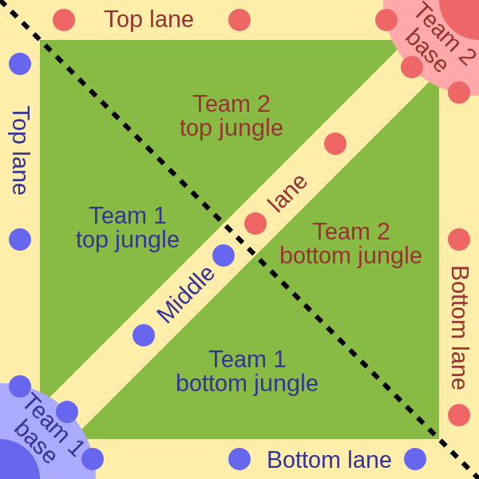
What is League of Legends? (continued)
There are currently 9 ranks that exists in this game:
Iron
Bronze
Silver
Gold
Platinum
Diamond
Master
Grandmaster
Challenger
The rank we worked on
Fig: Simplified representation of the game’s map

Slide 6
Purpose of research
Figure out whether a machine learning model is capable of predicting the winner of a competitive, high-skill match of League of Legends
Figuring out how relevant the game statistics are for a single match
Finding the relationship of certain statistics of a game with winning the game providing evidence of the significance of these aspects in competitive play
Proves the belief of many analysts and League coaches as to what aspects of the game are important for winning when it comes to tournaments

Slide 7
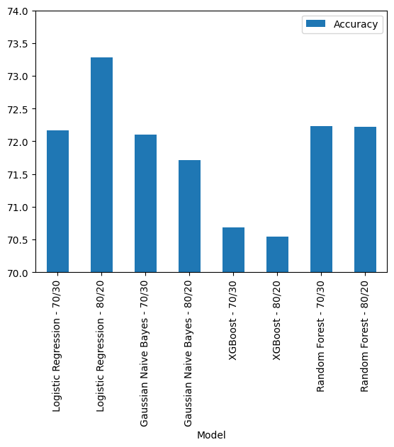
Results
Model | Split | Accuracy
Logistic Regression | 70/30 | 72.165992
 | 80/20 | 73.279352
Gaussian Naïve Bayes | 70/30 | 72.098516
 | 80/20 | 71.710526
XGBoost | 70/30 | 70.681511
 | 80/20 | 70.546559
Random forest | 70/30 | 72.233468
 | 80/20 | 72.216599

Slide 8
Thank You

